Slide 1
Power System Planning
Muhammad Kamran, PhD
Lecture-3
mkamran@uet.edu.pk

Slide 2
Lecture contents
Renewable Energy resources-Unconventional Energy sources

Slide 3
Renewable Energy Sources
To protect environment and for sustainable development, the importance of renewable energy sources can not be negated
It is an established and accepted fact that renewable and non-conventional forms of energy will play an increasingly important role in future as they are cleaner and easier to use and environmentally friendly and are bound to become economically more viable with increased use
Because of the limited availability of coal, there is considerable international effort into the development of alternative/new/non-conventional renewable/clean sources of energy

Slide 4
Wind Power
Winds are essentially created by the solar heating of the atmosphere
Several attempts have been made since 1940 to use wind to generate electric energy and development is still going on
However, techno economic feasibility has yet to be satisfactorily established
Wind as a power source is attractive because it is plentiful, inexhaustible and non-polluting
Further, it does not impose extra heat burden on the environment
Unfortunately, it is non-steady and undependable

Slide 5
Control equipment has been devised to start the wind power plant when ever the wind speed reaches 30 km/hr
Methods have also been found to generate constant frequency power with varying wind speeds and consequently varying speeds of wind mill propellers
Wind power may prove practical for small power needs in isolated sites
But for maximum flexibility, it should be used in conjunction with other methods of power generation to ensure continuity

Slide 6
For wind power generation, there are three types of operations: 1. Small, 0.5-10 kW for isolated single premises 2. Medium, 10-100 kW for communities 3. Large, 1.5 MW for connection to the grid. The theoretical power in a wind stream is given by P = 0.5 pAV³ W p=density of air =(1201g/m³ at NTP) V=mean air velocity (m/s) and A = swept area (m²)

Slide 7
For a rotor of 17 m diameter and a velocity of 48 km/hr, the theoretical power is 265 kW and the practical would be roughly half of this value
There are some distinctive energy end –use features of wind power system;
1- Most wind sites are in remote rural, island or marine area
2- Rural grid systems are likely to be “Weak” in these area since they carry relatively low voltage supplies like 33kV
There are always periods without wind

Slide 8
Solar Thermal Energy
At present, two technologies are being developed for conversion of solar energy to the electrical form
'In one technology, collectors with concentrators are employed to achieve temperatures high enough (700'C) to operate a heat engine at reasonable efficiency to generate electricity
However, there are considerable engineering difficulties in building a single tracking bowl with a diameter exceeding 30 m to generate perhaps 200 kw

Slide 9
The solar power tower generates steam for electricity production
There is a 10 MW installation of such a tower by the Southern California Edison Co' in USA using 1818 plane mirrors, each 7 m x 7 m reflecting direct radiation to the raised boiler
The other technology converts solar energy to the electrical form by means of silicon wafer photoelectric cells known as "Solar Cells"
Their efficiency is about 25% but practically it is 15%
Energy generation is free of cost but problem is cost of maintenance of solar cell
With the likelihood of a break through in the large scale production of cheap solar cells with amorphous silicon, this technology may compete with conventional methods of electricity generation, particularly as conventional fuels become rare

Slide 10
High temperature collectors
Where temperatures below about 95 °C are sufficient, as for space heating, flat-plate collectors of the non concentrating type are generally used
Because of the relatively high heat losses through the glazing, flat plate collectors will not reach temperatures much above 200 °C even when the heat transfer fluid is stagnant
Such temperatures are too low for efficient conversion to electricity.

Slide 11
The efficiency of heat engines increases with the temperature of the heat source
To achieve this in solar thermal energy plants, solar radiation is concentrated by mirrors or lenses to obtain higher temperatures – a technique called Concentrated Solar Power (CSP)
The practical effect of high efficiencies is to reduce the plant's collector size and total land use per unit power generated, reducing the environmental impacts of a power plant as well as its expense.

Slide 12
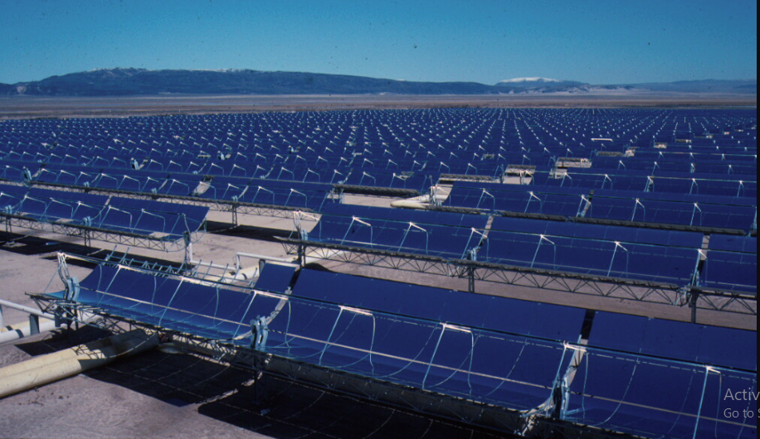
Part of the 354 MW SEGS solar complex in northern San Bernardino County, California

Slide 13
As the temperature increases, different forms of conversion become practical. Up to 600 °C, steam turbines, standard technology, have an efficiency up to 41%
Above 600 °C, gas turbines can be more efficient. Higher temperatures are problematic because different materials and techniques are needed
One proposal for very high temperatures is to use liquid fluoride salts operating between 700 °C to 800 °C, using multi-stage turbine systems to achieve 50% or more thermal efficiencies

Slide 14
The higher operating temperatures permit the plant to use higher-temperature dry heat exchangers for its thermal exhaust, reducing the plant's water use – critical in the deserts where large solar plants are practical
High temperatures also make heat storage more efficient, because more watt-hours are stored per unit of fluid

Slide 15
Solar Energy
The average incident solar energy received on earth’s surface is about 600 W/m² but the actual value varies considerably
Advantages are free of cost, non exhaustible and completely pollution free
Drawbacks are; energy density per unit area is very low, it is available only for a part of the day
Cloudy and hazy atmospheric conditions greatly reduce energy received
Utilizing solar energy for generation, challenging technological problems exist, the most important being that collection and concentration of solar energy and its conversion to the electrical from through efficient and with economic means

Slide 16
Wave Energy
The energy content of sea waves is very high
In long coast line countries, with several hundreds of kilometers of coastline, a vast source of energy is available
The power in the wave is proportional to the square of the amplitude and to the period of the motion
Therefore, the long period (~ 10 s), large amplitude (~ 2m) waves are of considerable interest for power generation, with energy fluxes commonly averaging between 50 and 70 kW/m width of on coming wave
Though the engineering problems associated with wave-power are formidable, the amount of energy that can be harnessed is large and development work is in progress

Slide 17
Wave Energy Phenomena
As the wind passes over the surface of the oceans, a portion of the winds kinetic energy is transferred to the water below, generating waves
In fact, the ocean could be viewed as a vast storage collector of energy transferred by the sun to the oceans, with the waves carrying the transferred kinetic energy across the surface of the oceans
The kinetic energy of the wave turns a turbine attached to a generator, which produces electricity
However, the open oceans can be a stormy and violent environment, resulting in the wave energy machines being destroyed by the energy they were designed to capture.

Slide 18
Physical phenomena
Waves are generated by wind passing over the surface of the sea
As long as the waves propagate slower than the wind speed just above the waves, there is an energy transfer from the wind to the waves
Both air pressure differences between the upwind and the side of a wave crest , as well as friction on the water surface by the wind, making the water to go into the shear stress causes the growth of the waves

Slide 19

In deep water where the water depth is larger than half the wavelength, the wave energy flux is;

Slide 20
with P the wave energy flux per unit of wave-crest length, H_{m0} the significant wave height, T_{e} the wave energy period, ρ the water density and g the acceleration by gravity
The above formula states that wave power is proportional to the wave energy period and to the square of the wave height
When the significant wave height is given in metres, and the wave period in seconds, the result is the wave power in kilowatts (kW) per metre of wave front length

Slide 21
Example: Consider moderate ocean swells, in deep water, a few km off a coastline, with a wave height of 3 m and a wave energy period of 8 seconds
Using the formula to solve for power, we get;
In major storms, the largest waves offshore are about 15 meters high and have a period of about 15 seconds
According to the above formula, such waves carry about 1.7 MW of power across each metre of wavefront

Slide 22
Biofuels
The material of plants and animals is called biomass, which may be transformed by chemical and biological processes to produce intermediate biofuels such as methane gas, ethanol liquid or charcoal solid
Biomass is burnt to provide heat for cooking, comfort heat (space heat), crop drying, factory processes and raising steam for electricity production and transport
Renewable energy programs are specially designed to meet the growing energy needs in the rural areas for promoting decentralized and hybrid development so as to stem growing migration of rural population to urban are as in search of better living conditions
It would be through this integration of energy conservation efforts with renewable energy programs that any country would be able to achieve a smooth transition from fossil fuel economy to sustainable renewable energy based economy and bring "Energy for all" for reasonable and environmental friendly sustainable development

Slide 23
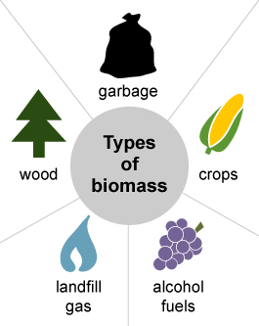
Biomass
Biomass is organic material that comes from plants and animals, and it is a renewable source of energy
Biomass contains stored energy from the sun
Plants absorb the sun's energy in a process called photosynthesis
When biomass is burned, the chemical energy in biomass is released as heat

Slide 24
Biomass
Growing crops of wood or other kinds of biomass to burn as fuel for generating electricity has some appeal as a means of utilizing the solar energy captured by photosynthesis for electrical power generation
The main advantages of biofuels are that they are renewable energy resources which ultimately do not contribute to global warming
Just as with fossil fuels however, burning biomass fuel to raise steam in conventional electricity generating plants also generates greenhouse gases
In the case of biomass however, the process of growing the new biomass is based on photosynthesis which uses energy captured from sunlight to extract CO₂ from the atmosphere and convert it into the combustible organic compounds thus offsetting the greenhouse gas generated by burning

Slide 25
Unfortunately the logistics often defeat the arguments for using biomass
The energy content of biomass is relatively low and vast areas of land are needed for cultivating the fuels and furthermore a lot of energy is required to harvest and move the crops to the power station

Slide 26
Parameters effecting Biofuels for energy generation
The energy content of biomass fuels, as harvested, is highly variable due to the variability of the moisture content of the fuel as well as the nature of the crop itself
Woods and grasses as harvested may have calorific values of only 10 GJ/tonne due their high moisture content, typically 50%, but the calorific value may be improved by drying the fuel
Natural air drying can reduce the moisture content to as low as 20% and oven drying to even lower levels enabling calorific values of 18 GJ/tonne or more to be achieved.

Slide 27
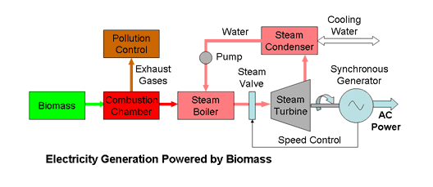
Electricity Generation Plant

Slide 28
Energy Storage
There is a lot problem in storing electricity in large quantities
Energy which can be converted into electricity can be stored in a number of ways
Storage of any nature is however very costly and its economics must be worked out properly
Various options available are: pumped storage, compressed air, heat, hydrogen gas, secondary batteries, fly wheels and superconducting coils

Slide 29
As already mentioned, gas turbines are normally used for meeting peak loads but are very expensive
A significant amount of storage capable of instantaneous use would be better way of meetings peak loads, and so far the most important way is to have a pumped storage plan
Secondary Batteries:
The most widely used storage battery is the lead acid battery
Sodium-sulphur battery (200 Wh/kg) and other combinations of materials are also being developed to get more output and storage per unit weight.

Slide 30
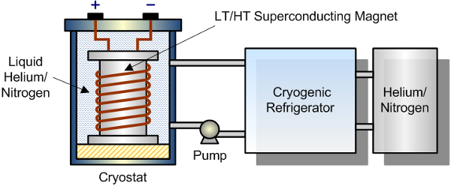
Super conductor

Slide 31
Superconducting Magnetic Energy Storage (SMES) systems store energy in the magnetic field created by the flow of direct current in a superconducting coil which has been cryogenically cooled to a temperature below its superconducting critical temperature
A typical SMES system includes three parts: superconducting coil, power conditioning system and cryogenically cooled refrigerator
Once the superconducting coil is charged, the current will not decay and the magnetic energy can be stored indefinitely.

Slide 32
The stored energy can be released back to the network by discharging the coil
The power conditioning system uses an inverter/rectifier to transform alternating current (AC) power to direct current or convert DC back to AC power
The inverter/rectifier accounts for about 2–3% energy loss in each direction
SMES loses the least amount of electricity in the energy storage process compared to other methods of storing energy
SMES systems are highly efficient; the round-trip efficiency is greater than 95%

Slide 33
Fuel Cells
A fuel cell converts chemical energy of a fuel into electricity directly, with no intermediate combustion cycle
In the fuel cell, hydrogen is supplied to the negative electrode and oxygen (or air) to the positive
Hydrogen and oxygen are combined to give water and electricity
The porous electrodes allow hydrogen ions to pass
The main reason why fuel cells are not in wide use is their cost (> $ 2000/kW)
Global electricity generating capacity from full cells will grow from just 75 Mw in 2001 to 15000 MW by 2010 USA
Germany and Japan may take lead for this…..

Slide 34
Hydrogen Energy System
Hydrogen can be used as a medium for energy transmission and storage
Electrolysis is a well-established commercial process yielding pure hydrogen
H₂ can be converted very efficiently back to electricity by means of fuel ceils
Also the use of hydrogen as fuel for aircraft and automobiles could encourage its large scale production, storage and distribution

Slide 35
System configuration
The system presented here includes a hydrogen production installation—via water electrolysis—using renewable energy sources, so as to use it in a fuel cell bus (FC)
Figure illustrates the system configuration
The renewable PV and wind power are taken as primary energy sources
It is noted that solar PV and wind systems cannot provide a continuous supply due to the fact that those systems will generate electricity only during sunny and windy days

Slide 36
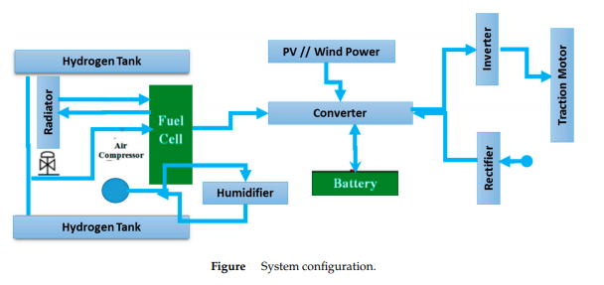

Slide 37
Hence, a combination of these two sources improves the overall energy output
A proper optimization is required to ensure having an optimal number and size of PV and Wind Turbine
All of the energy systems are connected in parallel to a common DC bus line through appropriate power electronic interfacing circuits
When there is an excess solar generation available, the electrolyser is activated to initiate the necessary hydrogen production for bus fueling, which is delivered to hydrogen storage tanks at low pressures

Slide 38
Solar and wind energy are converted to electricity via a PV non-tracking flat plate collector and a wind turbine
A bus fuel cell is made up, in general, of a fuel cell stack system, an air compressor system, a hydrogen supply system and an air refrigeration system
The fuel cell stack system generates the required power for the bus (Figure)
The air compression sub-system provides the essential oxygen, through air, to the fuel cells
The system contains two compressor stages, compression and hyper-compression, which are been driven by the air of evaporation of the fuel cell, an air to air exchanger, and the filters

Slide 39
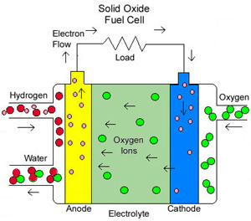
Fuel Cell

Slide 40
If free electrons or other substances could travel through the electrolyte, they would disrupt the chemical reaction
Whether they combine at anode or cathode, together hydrogen and oxygen form water, which drains from the cell
As long as a fuel cell is supplied with hydrogen and oxygen, it will generate electricity.

Slide 41
Next Lecture
Problems related to power generation using renewable resources (Lecture 3-a)
Distribution planning (Lecture 4)
Definitions and problems

